Slide 1


5BCA Project
MISSION
CHRIST is a nurturing ground for an individual’s holistic development to make effective contribution to the society in a dynamic environment
VISION
Excellence and Service
CORE VALUES
Faith in God | Moral Uprightness Love of Fellow Beings
Social Responsibility | Pursuit of Excellence
1

Slide 2
Under the guidance of
Dr KN Saravanan
Team Members:
K Abisheik 2241136
Pranav Srinivasan 2241149
Soravich Pinrat 2241158

Slide 3




ABSTRACT
MSMEs often need quick access to cash flow for their working capital needs.
Traditional funding sources, such as banks, can be slow to process loans, prompting MSMEs to seek faster solutions from financiers.
Our platform aims to simplify this process, allowing MSMEs to quickly find suitable financiers. At the same time, the platform helps financiers easily find appropriate borrowers.
It is designed to facilitate faster funding for MSMEs and enable small-scale financiers to compete with larger market players.

Slide 4

AGENDA
Introduction
Existing Systems
2.1 Limitations of Existing Systems
Proposed System
3.1 Objective
3.2 Application Areas
3.3 Flow Diagram
Requirement Analysis
4.1 Software Requirements
4.2 System Requirements
4.3 Modules/Functionalities
Database Design

Slide 5

INTRODUCTION
FinBridge is a digital platform that connects micro, small, and medium enterprises (MSMEs) with potential financiers. It streamlines the loan application process, enabling MSMEs to access funding quickly and efficiently while offering financiers a wider range of investment opportunities.
By enhancing financial inclusion and improving transparency, FinBridge supports the growth and success of small businesses.

Slide 6





EXISTING SYSTEMS
Traditional Banking Systems: Banks provide secure, regulated loans and comprehensive financial services, making them a reliable choice for MSMEs.
Peer-to-Peer (P2P) Lending Platforms: P2P platforms connect borrowers with individual lenders directly, offering flexible terms and an easy online application process.
Crowdfunding Platforms: These platforms allow businesses to raise funds from many people online, ideal for innovative projects without credit checks.
Faircent: An Indian P2P lending platform offering personal and business loans, with features like credit scoring and risk assessment.
Indifi: An Indian platform that connects small businesses with financial institutions for tailored loan products and fast disbursement.

Slide 7
LIMITATIONS OF EXISTING SYSTEMS
Traditional Banking Systems: Long approval times and strict eligibility can delay funding, with higher costs for MSMEs due to high interest rates and fees.
Peer-to-Peer (P2P) Lending Platforms: Increased risk of borrower default and less regulation make these platforms riskier for both borrowers and lenders.
Microfinance Institutions (MFIs): Small loan sizes and higher interest rates may not meet the larger funding needs of some MSMEs.
Crowdfunding Platforms: Success relies on crowd participation and can be time-consuming, potentially distracting from business operations.

Slide 8
Government Schemes and Initiatives: Complex applications and bureaucratic processes can delay funding; many MSMEs may be unaware of available schemes.
Funding Circle: Connects small businesses with investors for quick loans and competitive rates, but is geographically limited and focuses on established businesses.
Faircent: An Indian P2P platform offering loans and credit assessment but with stringent eligibility criteria.
Indifi: Connects small businesses with financial institutions for tailored loans and quick disbursement, but requires extensive documentation and is limited to certain business types.

Slide 9
PROPOSED SYSTEM
1. Streamlined Matching Process: FinBridge provides a seamless platform where MSMEs can quickly find suitable financiers based on specific loan requirements, reducing the time and effort needed to secure funding.
2. Broader Access for MSMEs: Unlike traditional banks, which have stringent criteria, FinBridge offers more inclusive access to financing options, catering to a wider range of MSMEs, including newer and smaller businesses.
3. Enhanced Transparency: The platform fosters transparency by allowing MSMEs and financiers to view detailed profiles, loan terms, and credit ratings, leading to more informed decision-making and building trust.
4. Reduced Risk for Financiers: FinBridge implements advanced risk assessment tools and credit scoring mechanisms to help financiers evaluate potential borrowers more accurately, mitigating the risk of default.

Slide 10
5. Simplified Process: Unlike complex government schemes and time-consuming crowdfunding campaigns, FinBridge offers a straightforward application and matching process, making it easier for both MSMEs and financiers to navigate.
6. Real-Time Updates and Communication: FinBridge ensures real-time updates on application status and facilitates secure communication between MSMEs and financiers, streamlining the negotiation and agreement process.
7. Educational Resources: The platform includes educational materials and tools to help MSMEs improve their financial literacy and business management skills, enhancing their overall readiness for funding.

Slide 11
OBJECTIVES
1. Quick Funding for MSMEs: Create a platform for MSMEs to easily connect with
financiers, addressing their urgent cash flow needs.
2. Support Small-Scale Financiers: Help small financiers compete with larger players by
giving them access to more potential borrowers.
3. Boost Financial Inclusion: Provide funding options for MSMEs that don’t have access to
traditional banking services.
4. Increase Efficiency and Transparency: Make the funding process easy and clear for both
MSMEs and financiers through a user-friendly platform.
5. Build Trust and Reliability: Include features like user reviews, ratings, and secure
communication to build trust on the platform.
6. Offer Educational Resources: Provide educational materials to help MSMEs improve their
financial knowledge and business management skills.

Slide 12
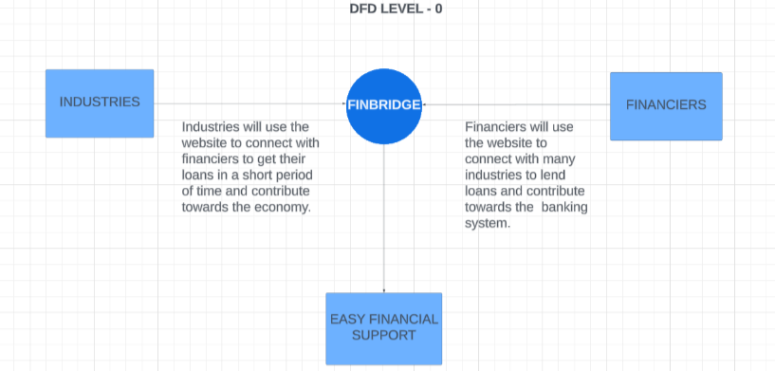
DFD Level 0

Slide 13
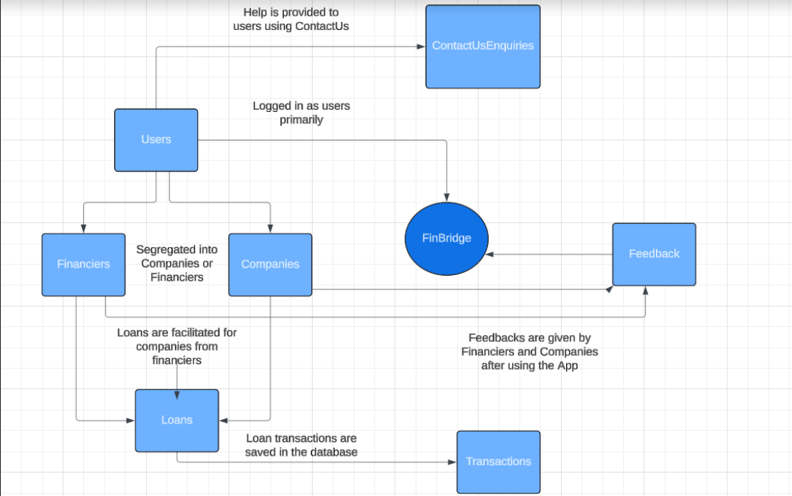
DFD Level 1

Slide 14
REQUIREMENT ANALYSIS
Hardware Requirements
Server: High-performance server to handle web traffic and database
operations.
Storage: Sufficient storage capacity for user data, loan applications, and
educational resources.
Backup: Reliable backup system for data recovery and redundancy.
Software Requirements
Frontend: HTML, CSS, and JavaScript for creating the user interface.
Backend: PHP for server-side scripting and application logic.
Database: MySQL for managing user data, loan applications, and
transactions.
APIs: Integration with external APIs for credit scoring and financial
services.
Network Requirements
WiFi required

Slide 15
FUNCTIONAL REQUIREMENTS
FR01: The registration module will capture user details such as name, contact information, business details for MSMEs, and loan offerings for financiers.
FR02: Users will be able to log in securely using their email and password, with an option for two-factor authentication.
FR03: MSMEs can fill out and submit loan applications online, including uploading necessary documentation.
FR04: The matching algorithm will analyze the loan requirements of MSMEs and match them with financiers based on criteria such as loan amount, interest rate, and repayment terms.

Slide 16
FR05: Users will have a personalized dashboard showing the status of their loan applications,
messages, and other relevant information.
FR06: Users can leave reviews and ratings for each other after a loan transaction is completed,
helping to build trust and reliability within the platform.
FR07: The platform will provide access to articles, videos, tutorials, and other resources to help MSMEs improve their financial literacy and business management skills.
FR08: The platform will integrate with external APIs for services such as credit scoring, payment
gateways, and other financial services to enhance functionality and provide accurate data.
FR09: Users will receive notifications via email and in-app alerts regarding the status of their loan applications, new messages, and other important updates to keep them informed.

Slide 17
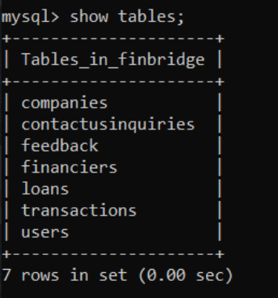
DATABASE DESIGN
The following database is created to meet with the requirements of the application.

Slide 18
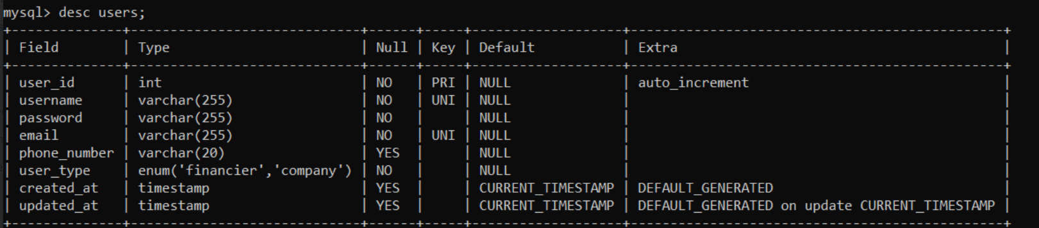
Users table
Stores information about all platform users.

Slide 19
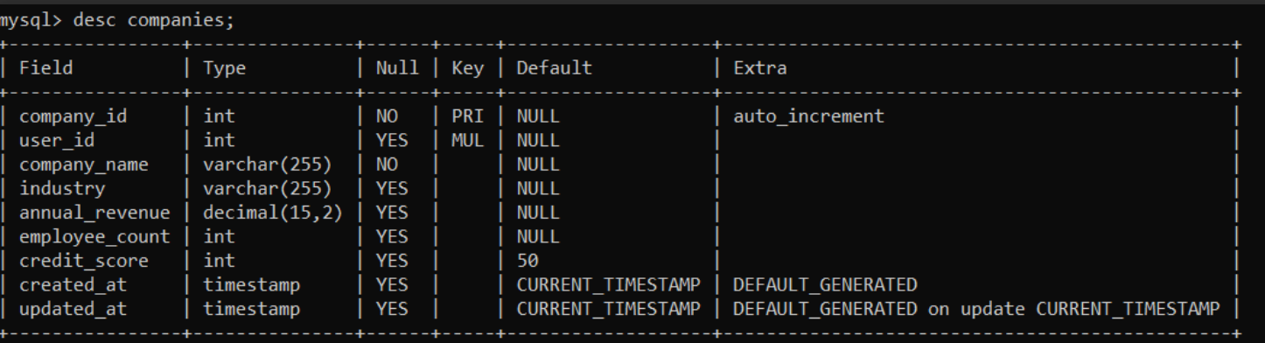
Companies table
Stores further information from users about their company.

Slide 20
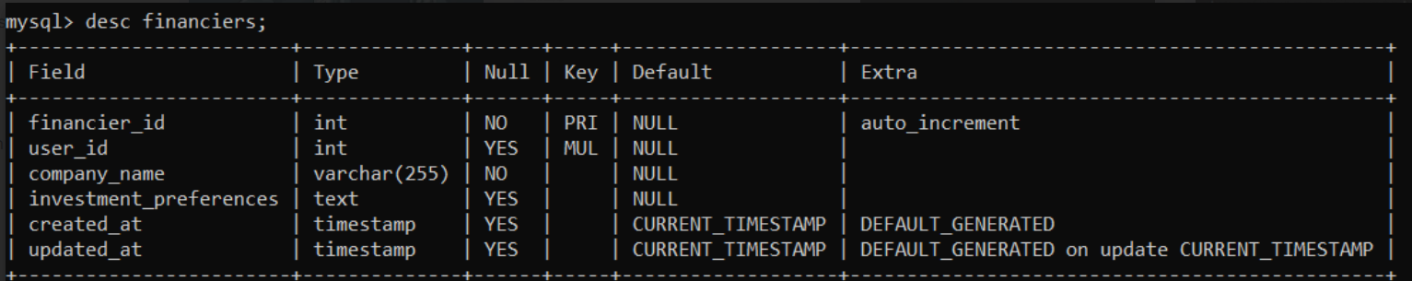
Financiers Table
Stores information about financier details if they are trying to invest

Slide 21
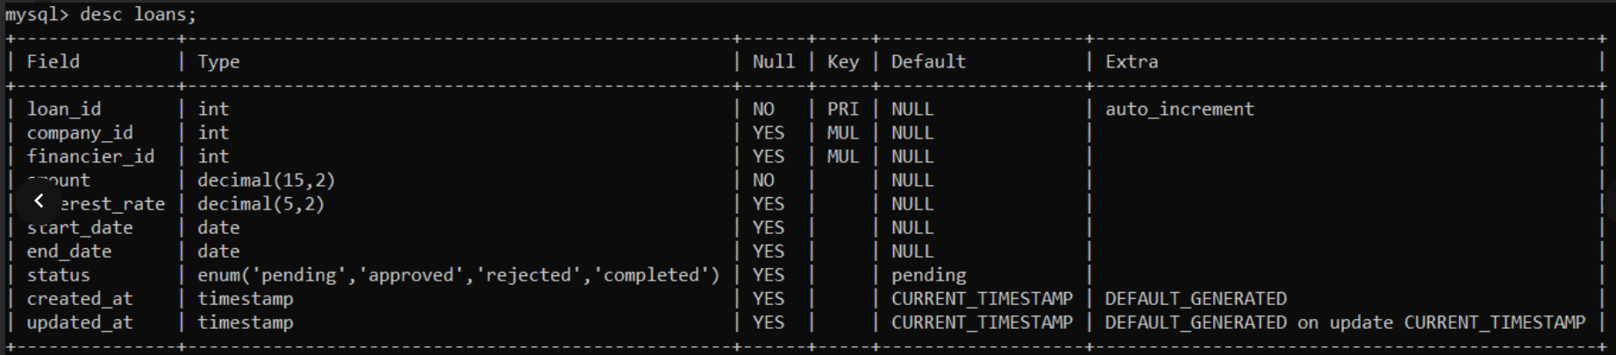
Loans table
Stores information about the loan details including financier details, period of loan, amount and interest.

Slide 22
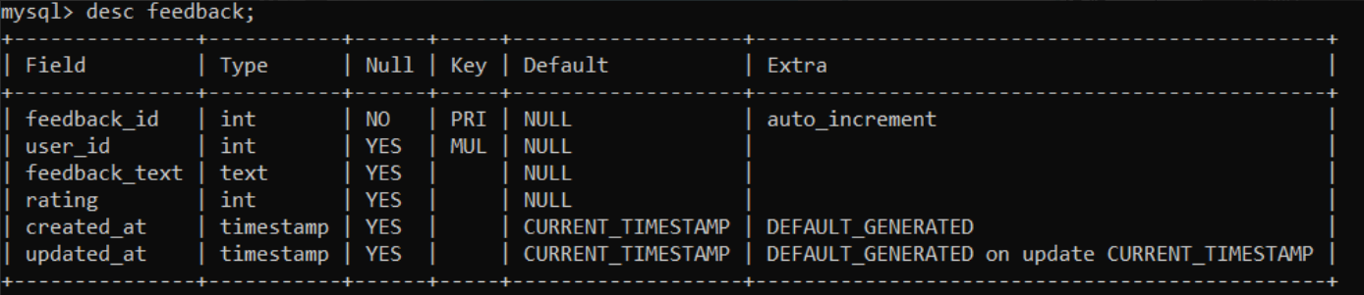
Feedback table
Stores user feedback and rating.

Slide 23
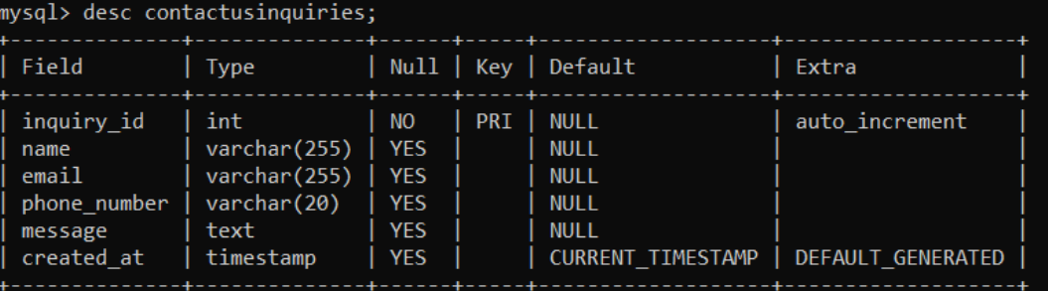
Contact us table
Stores contact details of anyone trying to reach out for queries.

Slide 24
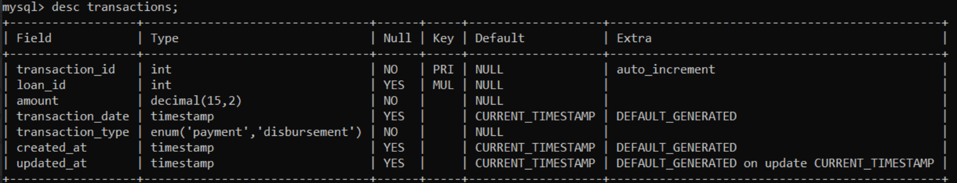
Transactions table
Stores transaction details.

Slide 25
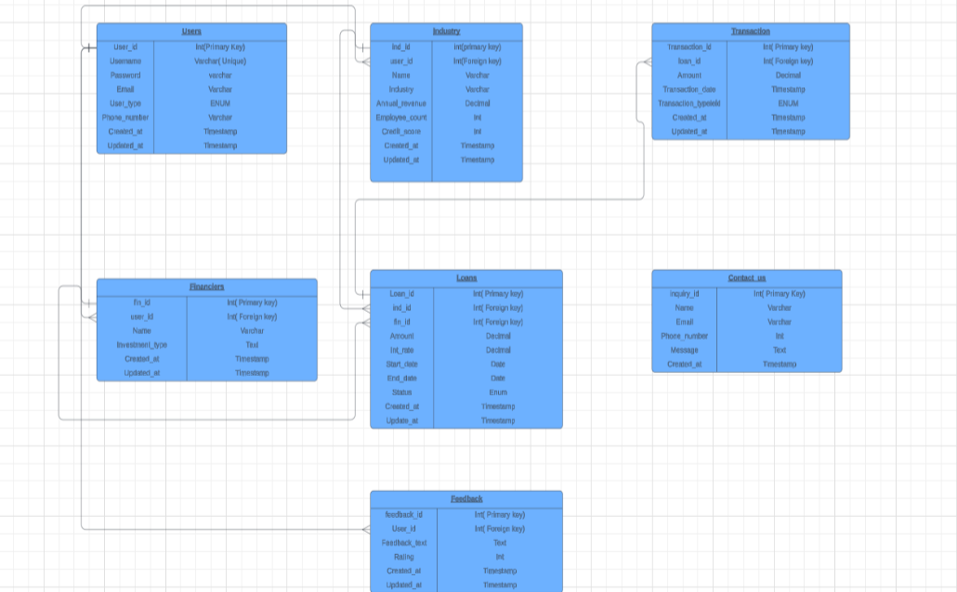
SCHEMA DIAGRAM

Slide 26
UI Design

Slide 27


LANDING PAGE:

Slide 28
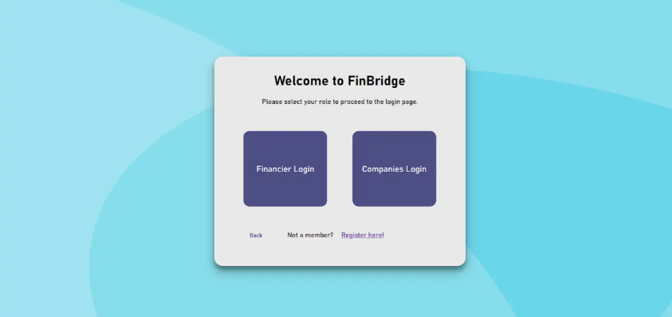
LOGIN PAGE:

Slide 29


FINANCIER LOGIN
MSME COMPANY LOGIN

Slide 30
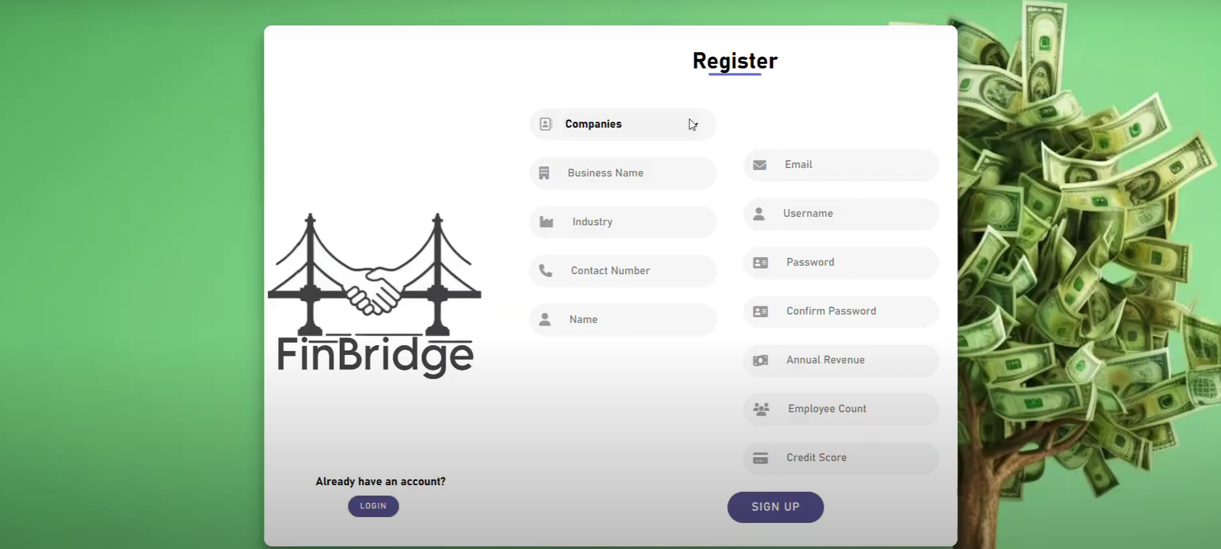
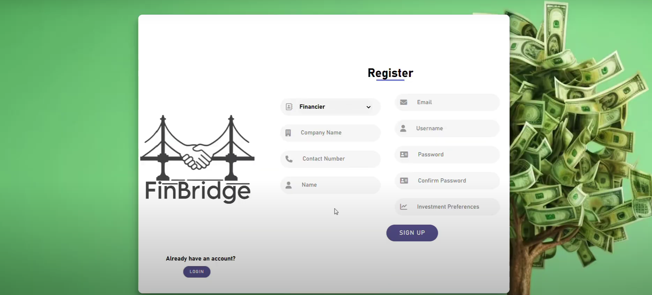

Slide 31
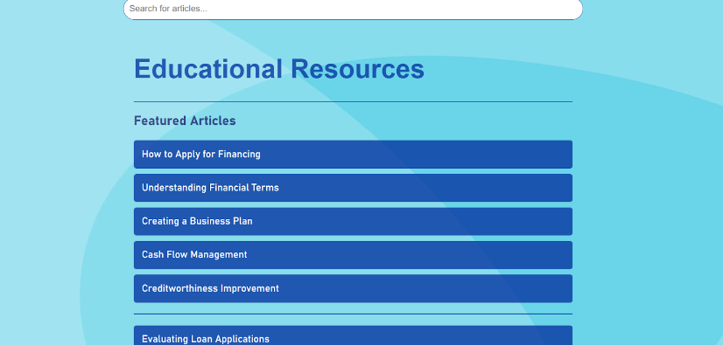
EDUCATIONAL RESOURCES:

Slide 32
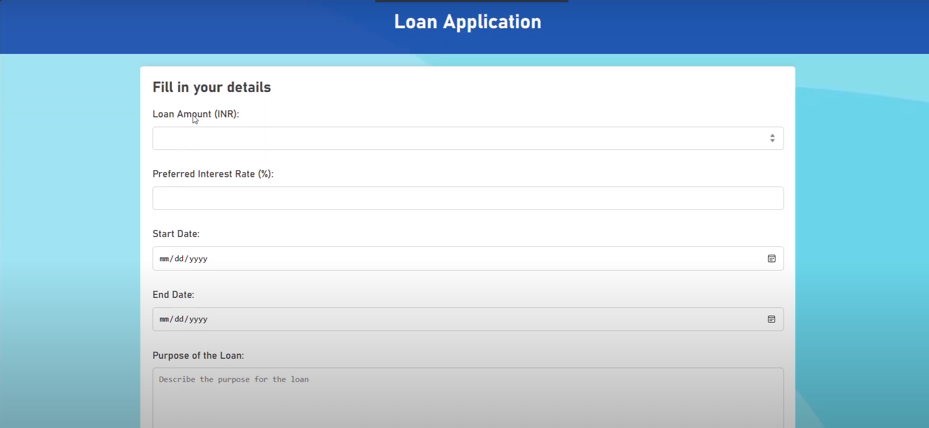
Loan Application

Slide 33

Application View

Slide 34
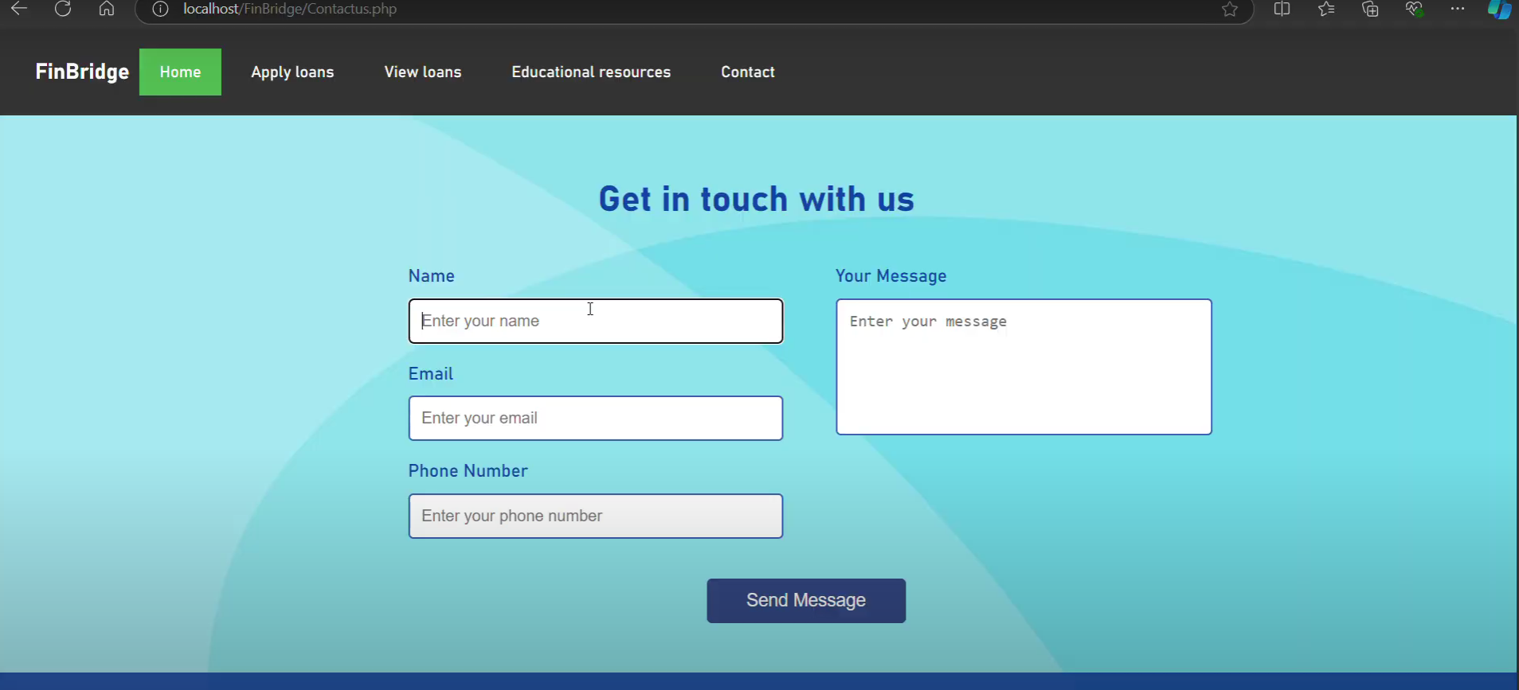
Contact Us Page

Slide 35
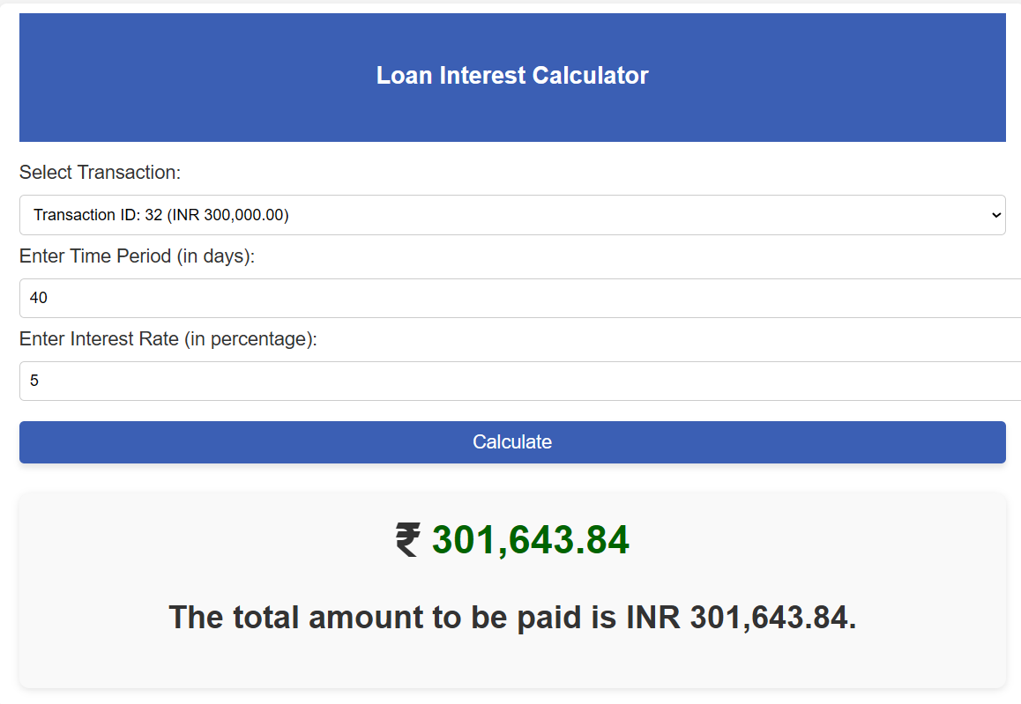
Loan calculator page

Slide 36

Main dashboard/ Rating page

Slide 37
THANK YOU

